Slide 1
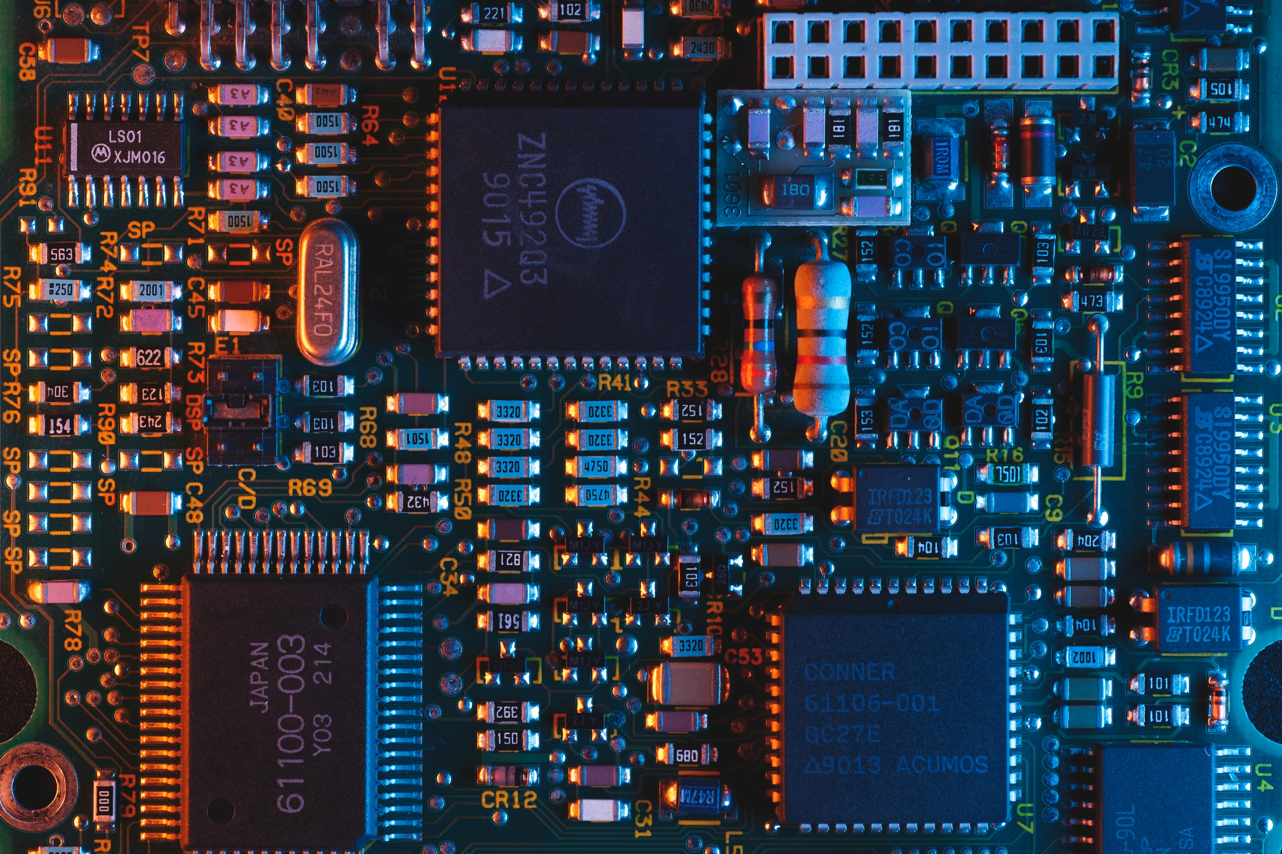

Applying TSR programming to display Real Time Digital Clock
INNOVATIVE EXAM – MICROPROCESSOR
02 – HIMANSHU AGARWAL
19 – MAANAV CHETTY
22 – MAHIMA CHURI

Slide 2
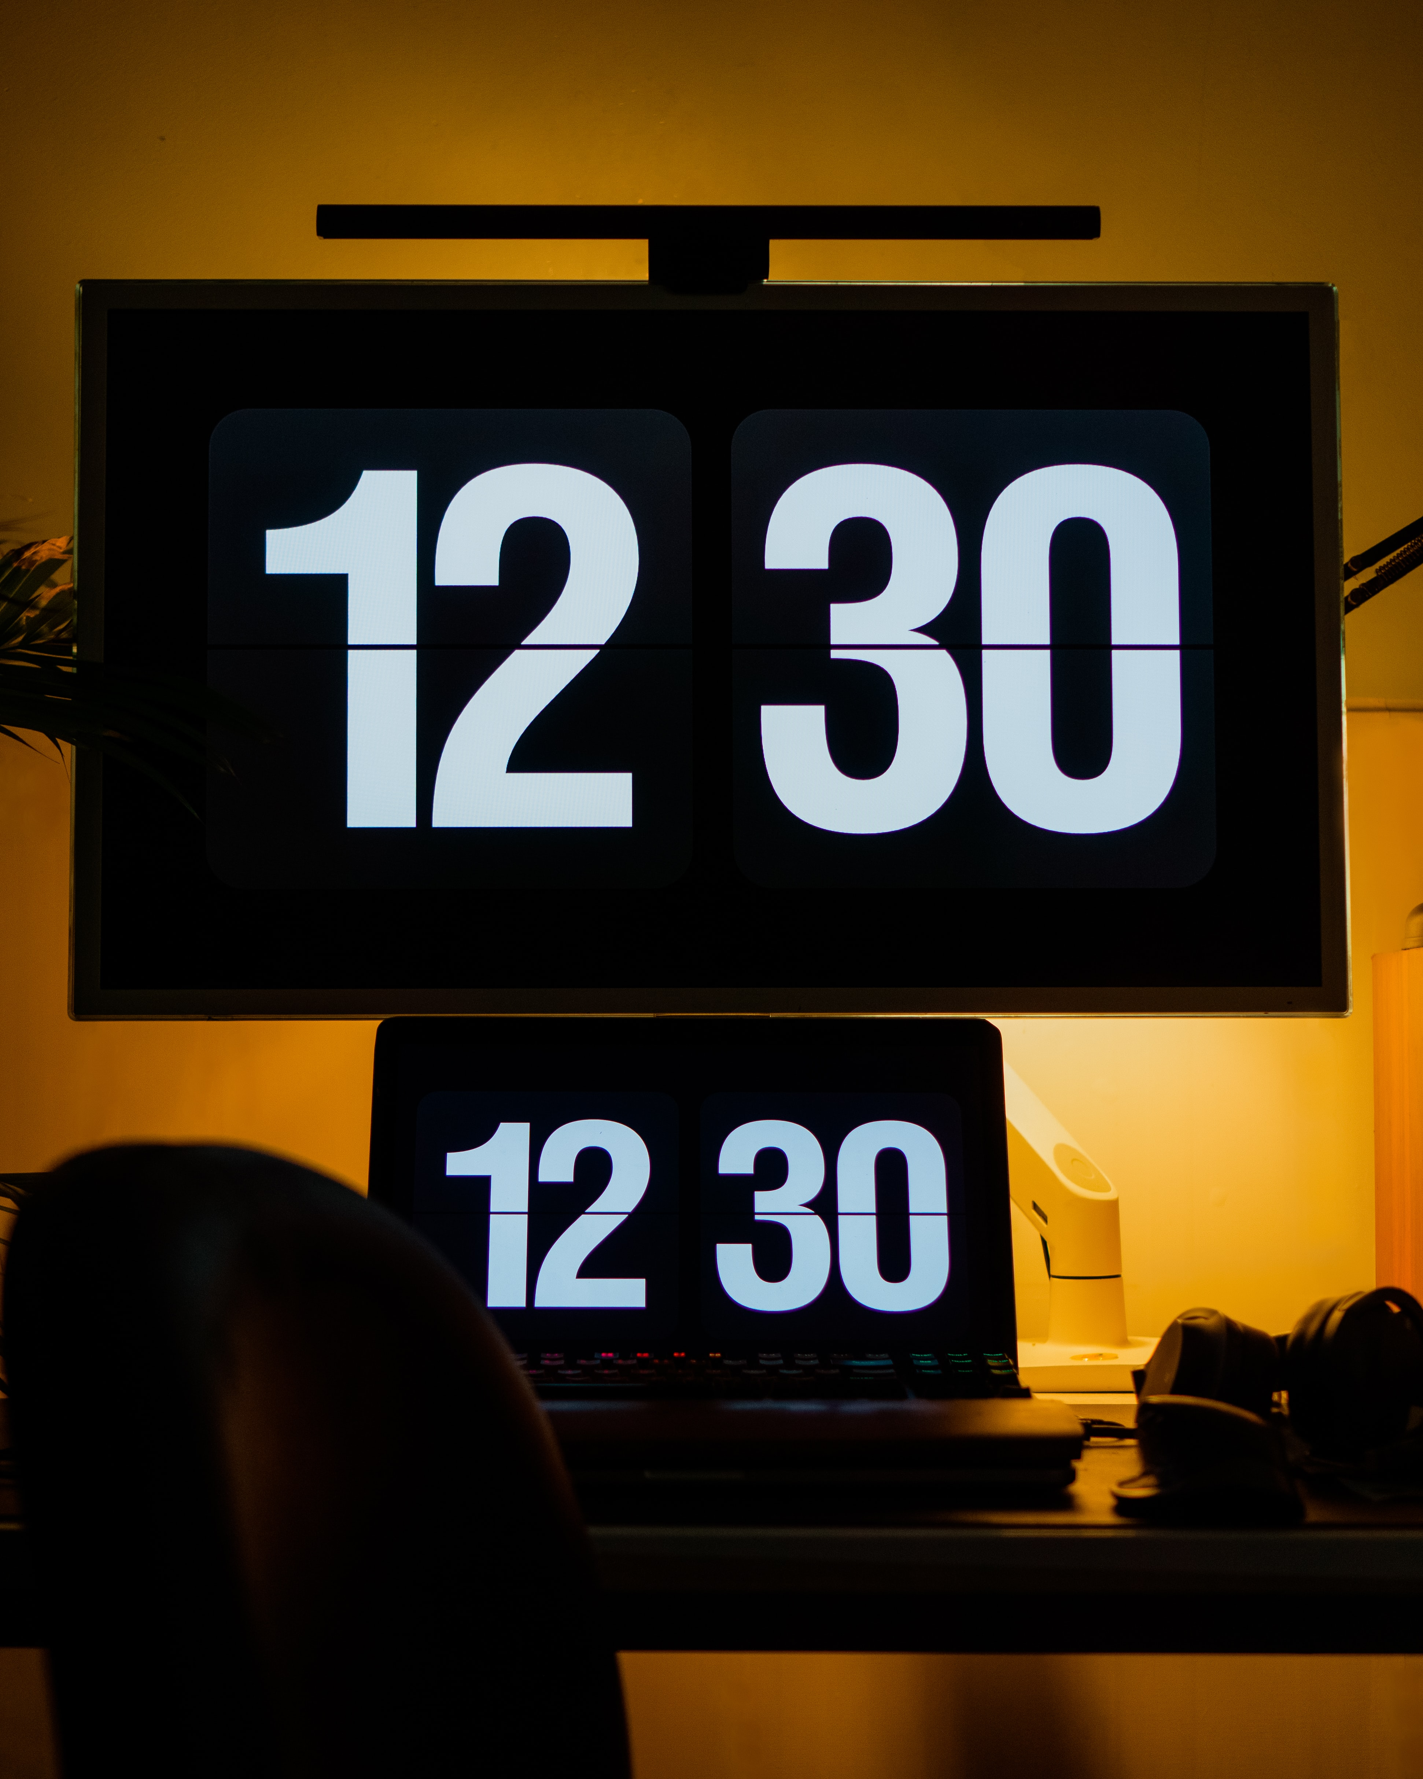
AGENDA
Introduction to our Problem
Tools Used
Algorithm
Code
Output
Conclusion
Acknowledgement

Slide 3

INTRODUCTION
TSR stands for Terminate and Stay Resident
There are two types of programs which we execute on system:
Transient programs
Resident programs
Structure of TSR programs
Data Area
Resident routine
Initialization routine
Tools Used: GUI Turbo Assembler

Slide 4

ALGORITHM
Algorithm for Resident Routine
ORG 100H
Unconditionally jump to initialization routine
Reserve memory locations to store the registers and original vector address
Store the registers temporarily
Read time
Initialize base address(B800h) of page-0 of video RAM in ES and offset(3984h) of allocation where we want to display the RTC,
Display HH:MM:SS
Restore the original register contents
Call the original interrupt service procedure

Slide 5
ALGORITHM
Algorithm of initialization routine
Clear interrupt flag to avoid any hardware interrupt during the process initialization,
Read the original vector address entry and store is in data area
Set the vector address to our interrupt service routine
Set interrupt flag
Terminate and make it resident
FORMULA TO CALCULATE OFFSET IN VIDEO RAM USING X,Y CO-ORDINATES= [(Y * 80)+X]*2

Slide 6
CODE
.MODEL TINY
.CODE
ORG 100H ;Compiler Directive to work with many variables
START:
JMP INIT
TEMPAX DW ?
TEMPBX DW ?
TEMPCX DW ?
TEMPDX DW ?
TEMPSI DW ?
TEMPDI DW ?
TEMPDS DW ?
TEMPES DW ?
SAVEINT08 DD ?
MYINT08:
MOV CS:TEMPAX, AX
MOV CS:TEMPBX, BX
MOV CS:TEMPCX, CX
MOV CS:TEMPDX, DX
MOV CS:TEMPSI, SI
MOV CS:TEMPDI, DI
MOV CS:TEMPDS, DS
MOV CS:TEMPES, ES
MOV AH, 02H ;Read Clock. Returns CH=HH, CL=MM, DH=SS in BCD
INT 1AH ;Real Time Clock Driver
MOV AX, 0B800H ;Base Address of the current page where the clock will be displayed
MOV ES, AX
MOV DI, 1984 ;Offset in Video RAM where we want to display HH:MM:SS
;To Display Hour (HH)
MOV BL, 02 ;Number of digits to display
UP1:
ROL CH, 4 ;BCD to ASCII Conversion of HH
MOV AL, CH
AND AL, 0FH
ADD AL, 30H
MOV AH, 17H ;Attribute Byte (BL R G B I R G B) 00010001
MOV ES:[DI], AX ;To transfer the physical address of current page to DI
INC DI

Slide 7
CODE
INC DI
DEC BL
JNZ UP1
;To Display Blinking ?:?
MOV AL, ':'
MOV AH, 17H
MOV ES:[DI],AX
INC DI
INC DI
;To Display Minute (MM)
MOV BL, 02 ;Number of digits to display
UP2:
ROL CL, 4 ;BCD to ASCII Conversion of MM
MOV AL, CL
AND AL, 0FH
ADD AL, 30H
MOV AH, 17H ;Attribute Byte (BL R G B I R G B) 00010001
MOV ES:[DI], AX ;To transfer the physical address of current page to DI
INC DI
INC DI
DEC BL
JNZ UP2
;To Display Blinking ?:?
MOV AL, ':'
MOV AH, 17H
MOV ES:[DI], AX
INC DI
INC DI
;To Display Seconds (SS)
MOV BL, 02
UP3:
ROL DH, 4 ;BCD to ASCII Conversion of SS
MOV AL, DH
AND AL, 0FH
ADD AL, 30H
MOV AH, 17H ;Attribute Byte (BL R G B I R G B) 00010001
MOV ES:[DI], AX ;To transfer the physical address of current page to DI

Slide 8
CODE
INC DI
INC DI
DEC BL
JNZ UP3
MOV AX, CS:TEMPAX
MOV BX, CS:TEMPBX
MOV CX, CS:TEMPCX
MOV DX, CS:TEMPDX
MOV SI, CS:TEMPSI
MOV DI, CS:TEMPDI
MOV DS, CS:TEMPDS
MOV ES, CS:TEMPES
JMP CS:SAVEINT08
INIT:
CLI ;Clear Interrupt Flag Only
MOV AH, 35H ;Get Interrupt Vector
MOV AL, 08H ;Read Character and attribute at cursor point
INT 21H
MOV WORD PTR SAVEINT08, BX
MOV WORD PTR SAVEINT08+2, ES
MOV AH, 25H ;Set Interrupt Vector
MOV AL, 08H ;Read Character and attribute at cursor point
LEA DX, MYINT08 ;Entry Point of ISR at DS:DX
INT 21H
MOV AH, 31H ;Used for Terminate and Stay Resident (TSR)
LEA DX, INIT ;Size of Memory Block or amount of memory that is to be reserved
STI ;Set Interrupt Flag
INT 21H
END START
.EXIT
END

Slide 9
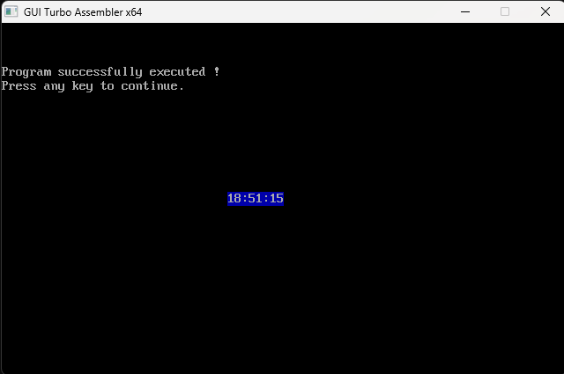
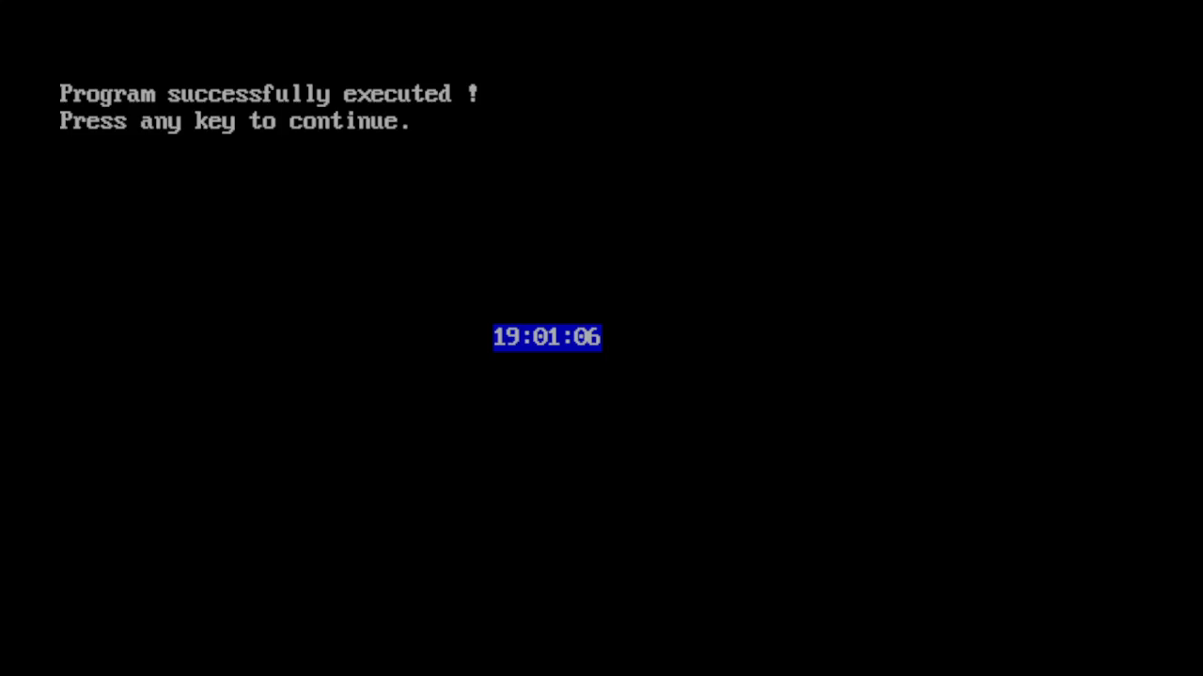
OUTPUT
SNAPSHOT
LIVESCREEN

Slide 10

CONCLUSION

Slide 11

Thank You

